Slide 1
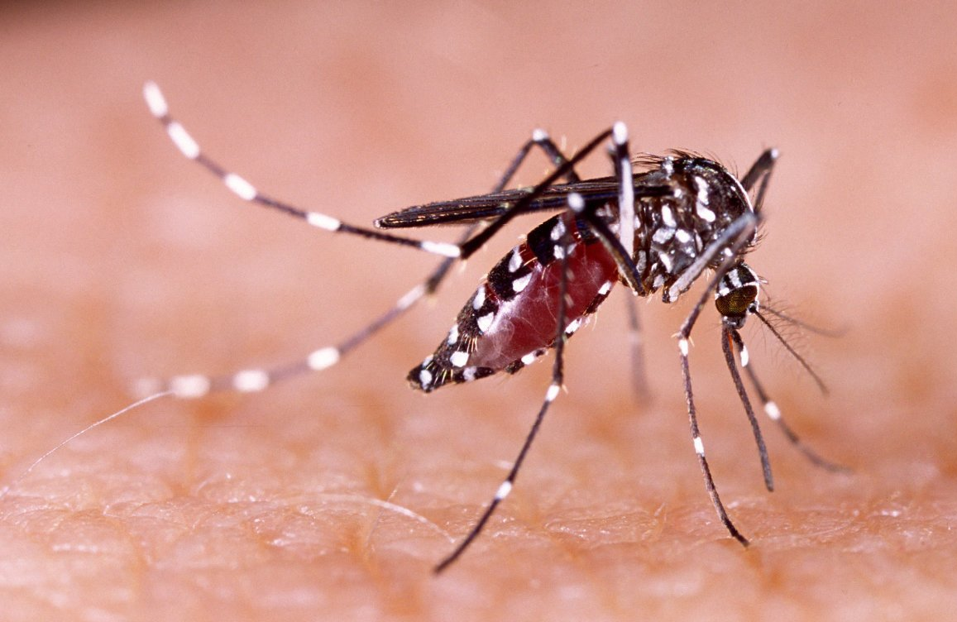
Temperature sensitivity of Dengue in Thailand
Project Proposal
Thaddeus Kühn, Dana Levi, Fiona Tanner, Frederik Racky
https://www.wissenschaft.de/wp-content/uploads/2/0/20-01-17-dengue.jpg

Slide 2
Overview
Data Background
Methods Milestones
Ideas Timeline

Slide 3
Datasets

